Slide 1
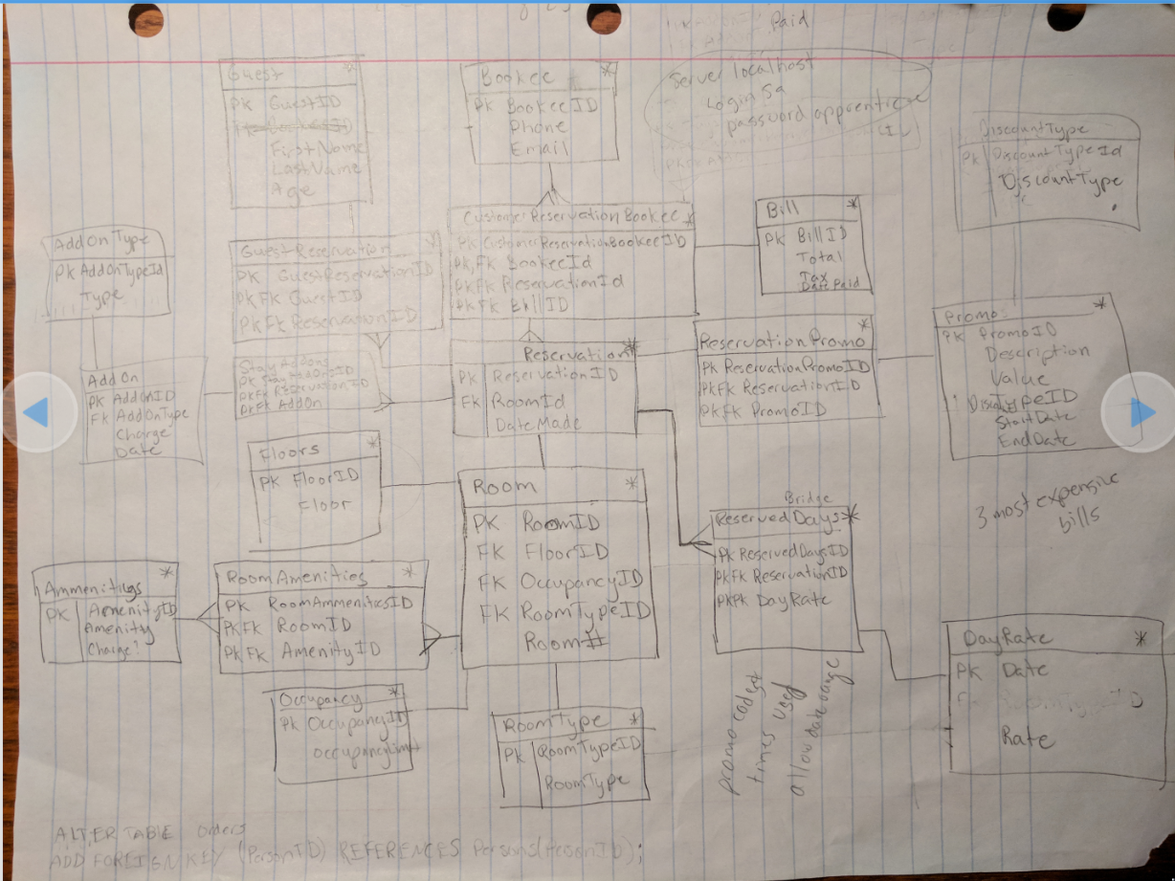
Hotel Reservation Design

Slide 2
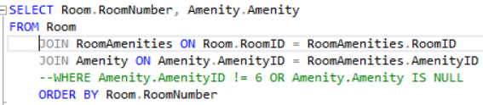
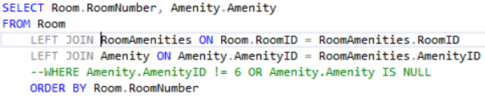
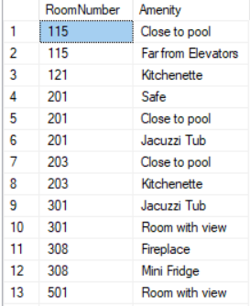
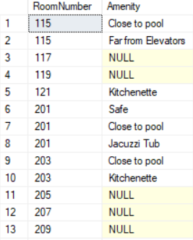
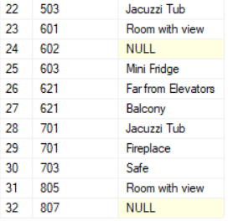
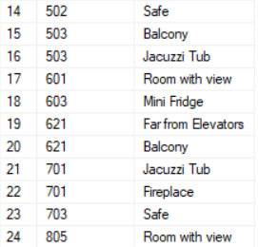


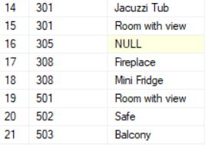
Query all rooms that do not have a particular amenity
32 Results
...I think I remember create rooms with no amenities.. near the end.. when i was getting lazy.
Yup.. sure did. Left join took care of that.
24 Results

Slide 3
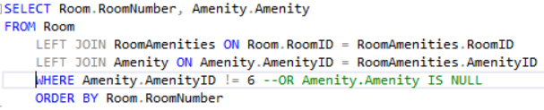
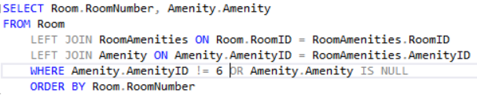
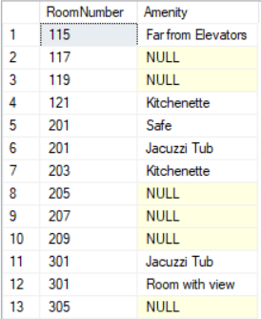
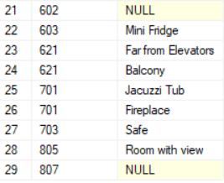
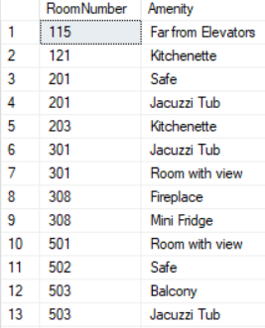

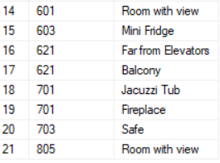
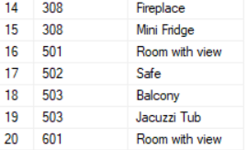
21 Results
29 Results
Evidently
“AmenityId != 6” actually means “AmenityId != 6 but ya can’t be empty!”
So now to just knock out those ones with id of 6.
WHAT? The nulls are gone again?

Slide 4
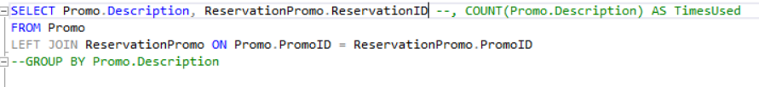

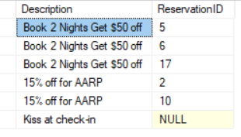
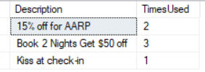
Number of Times Promos were used
Wait a sec… I don’t remember creating a test case for that last promo. What’s going on?
Is it counting my Null as 1? Maybe I don’t want a left join after all.

Slide 5



